Slide 1
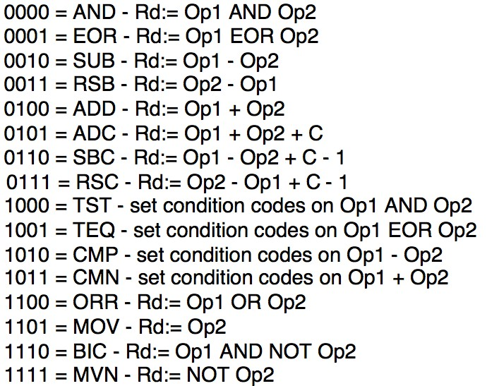

Slide 2
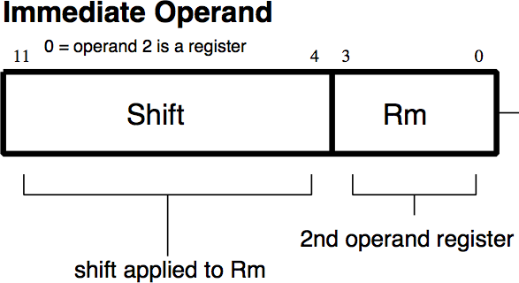
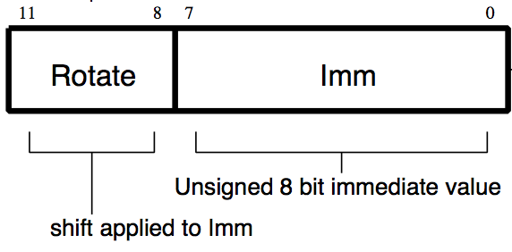
Data Processing Instructions
More fields:
I (Immediate)
0: Operand 2 is a Register
1: Operand 2 is an Immediate

Slide 3
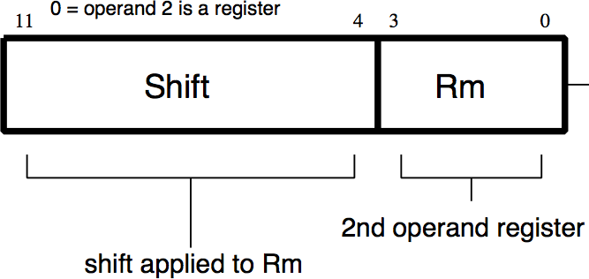
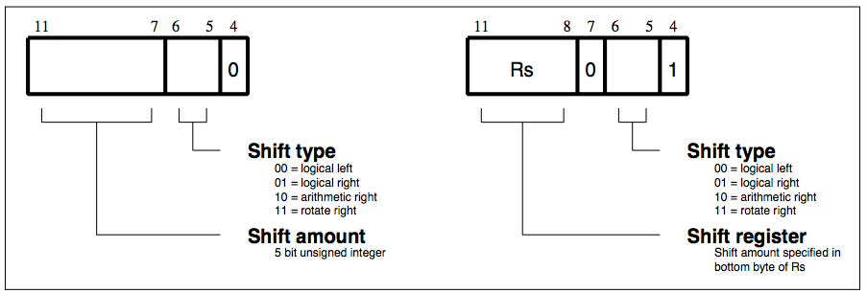
Data Processing Instructions
Operand 2:
Shift field:

Slide 4
Condition Field
jhjhjhjhjhjhjhjhjhjhjhjhjhjhjhjsasasasasasasassasasasasss

Slide 5

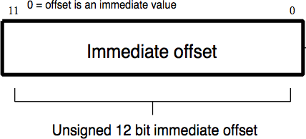
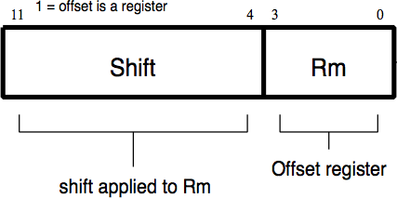
Data Transfer Instructions
Offset: source/destination register
I bit = 0
I bit = 1

Slide 6
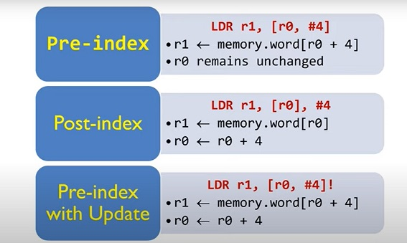
Addressing Mode

